Slide 1
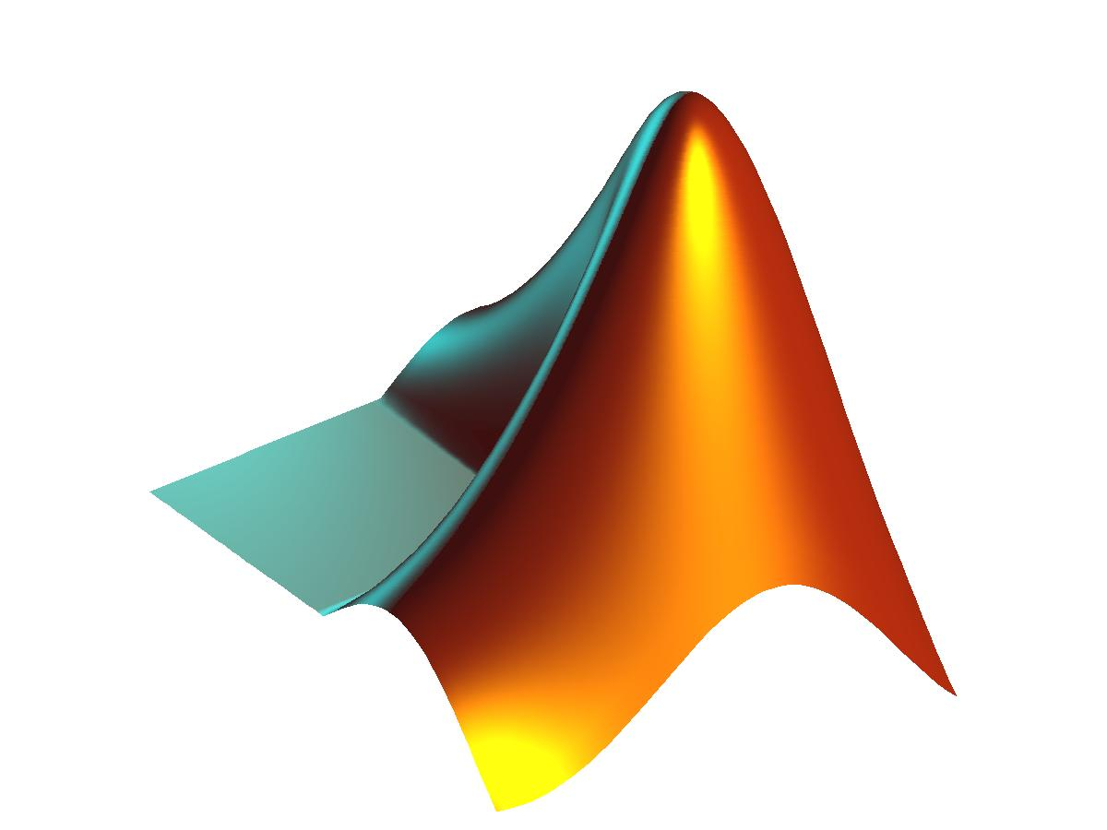
Chapter 3
Dr. Mohammad Husain

Slide 2
Special variables
ans : default variable name
pi : ratio of circle circumference to its diameter, π = 3.1415926...
inf or Inf : infinity e.g. 1/0
date : current date in a character string format, such as 15-Nov-2014.
clc : clears the command window, homes the cursor (moves the prompt to the top line), but does not affect variables.
clf : clears the current figure and thus clears the graph window
Punctuation and Comments
Semicolon (;) at the end of a command suppresses the display of the result
Commas and semicolons can be used to place multiple commands on one line, with commas producing display of results, semicolons suppressing
Percent sign (%) begins a comment, with all text up to the next line ignored by Matlab
Three periods (. . .) at the end of a command indicates that the command continues on the next line. A continuation cannot be given in the middle of a variable name.

Slide 3
% Find greatest number among three numbers declaring constant
a=10;
b=5;
c=15;
if (a >b) & (a>c)
'greater a'
elseif b>c
'greater b'
else
'greater c‘
end
% Find greatest number among three numbers using if-else statement
a=input('Type value of a :');
b=input('Type value of b :');
c=input('Type value of c :');
if (a >b) & (a>c)
'greater number is : a'
elseif b>c
'greater number is : b'
else
'greater number is : c'
end

Slide 4
Files and File Management
File : A collection of computer data, either ASCII text or binary, that is stored on an external memory device, such as a disk or tape drive.
File System: The combination of hardware and software that allows files to be stored (written), retrieved (read), and managed.
File Management: The process, implemented with a set of user commands, to manage the files in a file system. This involves defining the tree structure by creating or deleting directories and managing files by creating, moving, renaming, or removing them and listing their names and attributes.
Directory: Branch of a file tree, containing files and subdirectories; also called a folder.
Root directory: Base of file system, denoted by “C:\” in MS-DOS and MS Windows.
Present working directory: The branch of the file system in which you are currently located. Also called “current directory.” You have direct access to the files in this directory. Using “change directory” commands, you can move to another directory.
Home directory: When you log into your Unix account, your present working directory, is called your “home directory.”

Slide 5
User files: The user is given permission to manage all files in directories (branches) said to be below the home directory.
Path: Sequence of directories (branches) leading to a specific directory or file.
Matlab File Management
Matlab provides a group of commands to manage user files.
pwd: Print working directory – displays the full path of the present working directory.
cd path: Change to directory (folder) given by path, which can be either a relative or absolute path.
dir : Display the names of the directories (folders) and files in the present working directory.
what: Display the names of the M-files and MAT-files in the current directory.
delete file: Delete file from current directory
type file: Display contents of file (text file only, such as an M-file).

Slide 6
% Interactive Program to find greatest number among three numbers
a=input('Type value of a : ');
b=input('Type value of b : ');
c=input('Type value of c : ');
if (a >b) & (a>c)
fprintf('Greater number is : a \n')
elseif b>c
fprintf('Greater number is : b \n')
else
fprintf('Greater number is : c \n')
end
% Interactive Program to find Area of Circle
clc % To Clear the screen
r = input('Give radius of circle : ');
a = pi*r^2;
fprintf('The area of circle with radius %0.2f is %0.1f \n', r, a);

Slide 7
% Interactive Program to area of a trapezoid whose parallel sides are of length b1 and % b2 and whose height is h
clc % To Clear the screen
base1=input('Type value of base1 : ');
base2=input('Type value of base2 : ');
height=input('Type value of height : ');
area = 0.5*(base1 + base2)*height;
fprintf('The area of trapezoid is %0.3f \n', area);
% Convert from temperature in Fahrenheit to Celsius
clc % To Clear the screen
tf=input('Enter the temperature in fahrenheit : ');
tc=5/9*(tf-32);
fprintf('The temperature in degree Celsius is %0.2f \n', tc);
Consider the equation:
H(s) =(s² + 4s + 13)/(s³ − 2s² + 4s + 5)
% Solve the following equation
clc
s=input('Enter any number : ');
numerator = s^2 + 4*s + 13;
denominator = s^3 - 2*s^2 + 4*s + 5;
H = numerator/denominator;
fprintf('The value of H is = %0.2f \n', H);

Slide 8
Use of math functions to solve the following problem
X=√2/2
y =1/√2π * (e^{−x2/2})
z = 20log₁₀ y
% Solution of the above equation
clc
x = sqrt(2)/2;
fprintf('The value of x is = %0.4f \n', x);
y = exp(-(x^2)/2)/sqrt(2*pi);
fprintf('The value of y is = %0.4f \n', y);
z = 20*log10(y);
fprintf('The value of z is = %0.4f \n', z);
Accuracy, Precision, and Errors
Accuracy is a measure of the nearness of a value to the correct or true value.
Precision refers to the repeatability of a measurement, this how close successive measurements are to each other.
Errors: All measurements will have some degree of error. Identifiable and correctable errors are called systematic. Accidental or other non identifiable errors are called random.
error = true value - calculated value relative error = error/(true value)

Slide 9
Interpolation
One Dimensional Interpolation
Interpolation of functions is one of the classical problems in numerical analysis. A one
dimensional interpolation problem is formulated as follows.
Given set of n+1 points xk , yk, 0 k n, with x0 < x1 < … < xn, find a function f(x) whose graph interpolates the data points, i.e., f(xk) = yk, for k = 0, 1, …, n.
The general form of the function interp1 is yi = interp1(x, y, xi, method), where the vectors x and y are the vectors holding the x- and the y- coordinates of points to be interpolated, respectively, xi is a vector holding points of evaluation, i.e., yi = f(xi) and method is an optional string specifying an interpolation method. The following methods work with the function interp1
Nearest neighbor interpolation, method = 'nearest'. Produces a locally piecewise constant interpolant.
Linear interpolation method = 'linear'. Produces a piecewise linear interpolant.
Cubic spline interpolation, method = 'spline'. Produces a cubic spline interpolant.
Cubic interpolation, method = 'cubic'. Produces a piecewise cubic polynomial.
In this example, the following points (xk, yk) = (k pi/5, sin(2xk)), k = 0, 1, … , 5
Cubic Interpolation of y=Sin(2x)
x = 0:pi/5:pi;
y = sin(2.*x);
xi = 0:pi/100:pi;
yi = interp1(x, y, xi, 'cubic');
plot(x, y, 'o', xi, yi), title('Cubic interpolant of y = sin(2x)’)

Slide 10
Interpolation by splines
Here we deal with interpolation by polynomial splines. In recent decades splines
have attracted attention of both researchers and users who need a versatile approximation tools.
We begin with the definition of the polynomial spline functions and the spline space.
Given an interval [a, b]. A partition of the interval [a, b] with the breakpoints
{xl}1^{m} is defined as = {a = x1 < x2 < … < xm = b}, where m > 1. Further, let k and n, k < n, be nonnegative integers. Function s(x) is said to be a spline function of degree n with smoothness k if the following conditions are satisfied:
(i) On each subinterval [xl, xl+1] s(x) coincides with an algebraic polynomial of degree at most n.
(ii) s(x) and its derivatives up to order k are all continuous on the interval [a, b]
In this example we will interpolate Runge's function g(x) = 1/(1 + x²) on the interval [0, 5] using six evenly spaced breakpoints
x = 0:5;
y = 1./(1 + x.^2);
xi = linspace(0, 5);
yi = spline(x, y, xi);
plot(x, y, 'o', xi, yi), title('Cubic spline interpolant')

Slide 11
Two Dimensional Interpolation
MATLAB's built-in function zi = interp2(x, y, z, xi, yi, 'method') generates a bivariate interpolant on the rectangular grids and evaluates it in the points specified in the arrays xi and yi.
Sixth input parameter 'method' is optional and specifies a method of interpolation. Available methods are:
'nearest' - nearest neighbor interpolation
'linear' - bilinear interpolation
'cubic' - bicubic interpolation
'spline' - spline interpolation
In the following example a bivariate function z = sin(x² + y²) is interpolated on the square –1 x 1, -1 y 1 using the 'linear' and the 'cubic' methods.
Bilinear Interpolation
[x, y] = meshgrid(-1:.25:1);
z = sin(x.^2 + y.^2);
[xi, yi] = meshgrid(-1:.05:1);
zi = interp2(x, y, z, xi, yi, 'linear');
surf(xi, yi, zi), title('Bilinear interpolant to sin(x^2 + y^2)‘)

Slide 12
Thank You !!!

